Slide 1
Analysis of Running Data
Beth Harvey
June 12, 2023

Slide 2
Table of Contents
Background
Goals
EDA
Goal 1 Analysis
Goal 2 Analysis
Conclusions

Slide 3
1. Data Background

Slide 4
1.1 Data Background and Preparation
The original CSV file (activities_all) is exported from my Garmin Connect account and contains the data collected by my Garmin watch.
This includes information like:
> Distance in miles
> Average mile pace
> Minimum/maximum elevation
> Total time
> Average heart rate
Weather data was not included in the CSV file, so it was added manually.
Several default columns for other activities were removed.
Original date range: December 26, 2015 – September 21, 2022
> 2015-2016 were removed due to sparse data
> Activities that were not standard “running” were removed for consistency
> Activities under 2 miles in length were removed, since those are not representative

Slide 5
2. Goals

Slide 6
2.1 Goals of Analysis
Goal 1:
Use a two-sample t-test to compare my average mile pace for all activities before March 20, 2022 to those after that date to see if there is a significant difference.
Used ANOVA and Tukey’s Range Test to compare my average mile paces from March 20 - September 21 for each year included in the dataset.
Null Hypothesis: There is no difference in my average mile pace before and after March 20, 2022.
Alternative Hypothesis: There is a difference in my average mile pace before and after March 20, 2022.
Significance Level: 0.05
Goal 2:
Create a model to predict my average mile pace based on features of the run, such as temperature, distance, and elevation.
Test several different models to see which is the most accurate, if any.

Slide 7
3. Exploratory Data Analysis

Slide 8
3.1 Mile Pace Distribution
The distribution of my average pace per mile is approximately normally distributed, but slightly right-skewed.

Slide 9
3.2 Total Miles by Year
The total number of miles I ran per year was fairly consistent from 2017-2019 and from 2020-2022. This is most likely because I trained for races in 2017, 2018, and 2019, which leads to me running more.
This data is limited to January - September of each year, because that’s all the data I had for 2022.

Slide 10
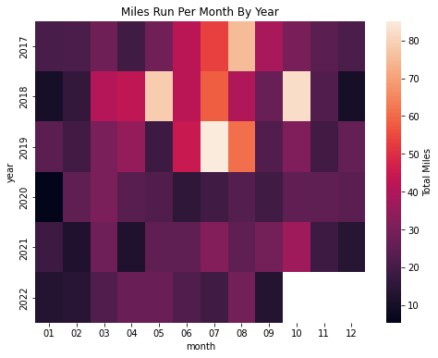
3.3 Miles per Month by Year
The heatmap of miles run per month by year highlights the training I did for races in 2017-2019. The highest number of miles per month is in the summers of each of those years.
I typically run the least in January and December.

Slide 11
3.4 Average Run Distance by Year
Not only did I run more miles in 2017-2019, but I also ran farther in each individual run on average.
In 2020-2022 I consistently averaged roughly 3.5 miles per run.

Slide 12
4. Goal 1 Analysis

Slide 13
4.1 Datasets
Limit the data to just the runs with a distance between 3 and 4 miles (activities_3_4).
Divide activities_3_4 into data from before and after March 20, 2022 (activities_after and activities_before for the two-sample t-test.
Divide activities_3_4 into datasets for March 20 - September 21 of each year for the ANOVA and Tukey’s Range Test.
# Get data for runs between 3 and 4 miles in length
activities_3_4 = activities_reg[(activities_reg.distance >= 3) & (activities_reg.distance <= 4)]
# Get data for runs after March 20, 2022)
activities_after = activities_3_4[activities_3_4.date >= '2022-03-20']
# Get data for runs before March 20, 2022 (set 2)
activities_before = activities_3_4[activities_3_4.date < '2022-03-20']
# Get data for March - September for previous years (set 3)
summer_2017 = activities_before[(activities_before.date >= '2017-03-20') & (activities_before.date <= '2017-09-21')]
summer_2018 = activities_before[(activities_before.date >= '2018-03-20') & (activities_before.date <= '2018-09-21')]
summer_2019 = activities_before[(activities_before.date >= '2019-03-20') & (activities_before.date <= '2019-09-21')]
summer_2020 = activities_before[(activities_before.date >= '2020-03-20') & (activities_before.date <= '2020-09-21')]
summer_2021 = activities_before[(activities_before.date >= '2021-03-20') & (activities_before.date <= '2021-09-21')]

Slide 14
4.2 Two-Sample t-test
I used ttest_ind from scipy.stats to run a two-sample t-test comparing my average mile pace before and after March 20, 2022.
Because the ratio of the standard deviations for the two datasets is not close to 1 (1.5), equal_var = False was needed.
The resulting p-value was greater than the significance level of 0.05, so there is not enough evidence to reject the null hypothesis that there is not a significant difference in my average pace from before and after March 20, 2022.
tstat, pval = ttest_ind(activities_before.avg_pace_int, activities_after.avg_pace_int, equal_var = False)
print(pval)
Output: 0.9836838069182449

Slide 15
4.3 One-Way ANOVA
I used f_oneway from scipy.stats to compare my average mile pace for March 20 - September 21 of each of the years in the dataset.
The resulting p-value was less than the significance level of 0.05, indicating that at least one of the pairs was significantly different, and a Tukey’s Range Test was needed to determine where the significance was.
fstat, pval = f_oneway(activities_after.avg_pace_int, summer_2017.avg_pace_int, summer_2018.avg_pace_int, summer_2019.avg_pace_int, summer_2020.avg_pace_int, summer_2021.avg_pace_int)
print(pval)
Output: 0.0008007860446498849

Slide 16
4.4 Tukey’s Range Test: Data
In order to easily compare just the March - September data for each year, I created an additional dataset called activities_summer.
This was used for the Tukey’s Range Test to determine which pair(s) had significant differences.
# Concatenate all summer datasets for Tukey test
summer = pd.concat([summer_2017, summer_2018, summer_2019, summer_2020, summer_2021, activities_after])

Slide 17
4.5 Tukey’s Range Test: Results
I used pairwise_tukeyhsd from statsmodels.stats.multicomp to determine which pairs of years were significantly different.
The year pairs with significant differences in average mile pace are 2018/2021 and 2021/2022. This indicates that 2021 is the year that is most different from the others, not 2022.
The null hypothesis can be rejected for those two pairs.
tukey_results = pairwise_tukeyhsd(summer.avg_pace_int, summer.year, 0.05)
print(tukey_results)
Output:
Multiple Comparison of Means - Tukey HSD, FWER=0.05
====================================================
group1 group2 meandiff p-adj lower upper reject
----------------------------------------------------
2017 2018 0.0326 1.0 -0.8454 0.9107 False
2017 2019 -0.1833 0.996 -1.2423 0.8756 False
2017 2020 0.3607 0.7673 -0.4259 1.1473 False
2017 2021 0.5598 0.3044 -0.2204 1.3401 False
2017 2022 0.1703 0.9882 -0.6099 0.9506 False
2018 2019 -0.216 0.9799 -1.094 0.6621 False
2018 2020 0.3281 0.446 -0.1899 0.846 False
2018 2021 0.5272 0.0373 0.0189 1.0355 True
2018 2022 0.1377 0.9693 -0.3706 0.6459 False
2019 2020 0.5441 0.3451 -0.2425 1.3307 False
2019 2021 0.7432 0.0714 -0.0371 1.5234 False
2019 2022 0.3537 0.776 -0.4266 1.1339 False
2020 2021 0.1991 0.4866 -0.1266 0.5248 False
2020 2022 -0.1904 0.537 -0.5161 0.1353 False
2021 2022 -0.3895 0.0054 -0.6996 -0.0795 True
----------------------------------------------------

Slide 18
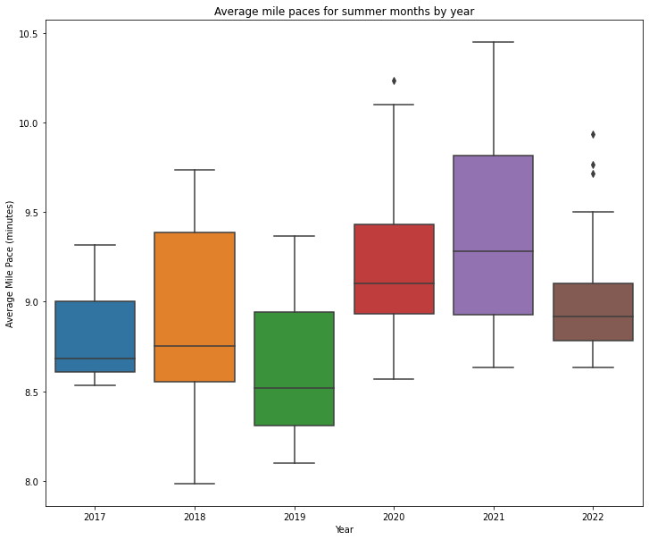
4.6 Visual Comparison of ANOVA Data
A side-by-side boxplot of my mile pace data by year confirms the results from the ANOVA and Tukey tests.
My average pace for 2021 is the highest of all the years, and the range is also large.
The years where I was training for a race (2017-2019) had faster average paces in general than years when I was not (2020-2022).
Contrary to my hypothesis, my average mile pace in 2022 is similar to the years when I was training for a race. It also has the smallest IQR.

Slide 19
5. Analysis of Goal 2

Slide 20
5.1 Feature Selection
I limited the features to only include factors that are external to my performance.
I also excluded features that are too highly correlated (ex: min. elevation and max. elevation).
My final feature set consisted of:
> Distance
> Temperature
> Humidity
> Month
> Total elevation change
The target feature was my average mile pace.
# Limit features to factors external to the run
# Target is average mile pace
feature_list = ['distance', 'temp', 'humidity', 'month', 'elev_diff’]
X = activities_reg[feature_list]
y = activities_reg['avg_pace_int']

Slide 21
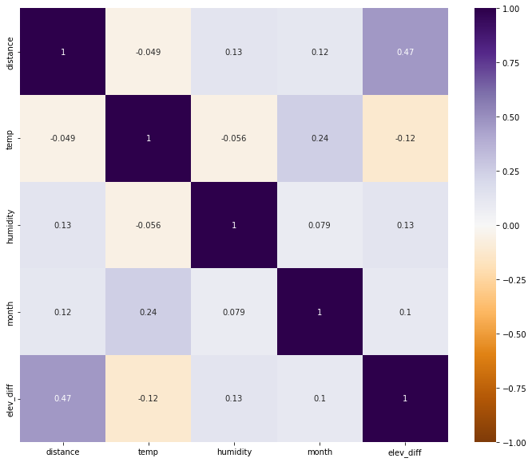
5.2 Check for Multicollinearity
I used a heatmap to check for multicollinearity between different parameters.
Most of the selected features had very low collinearity. The highest was the pair of distance and total elevation difference.

Slide 22
5.3 Models
Simple linear regression
Linear regression with 2nd-degree polynomial features and standard scaling
Support vector regression with standard scaling and a radial basis function kernel
Decision tree regression with standard scaling and maximum depth of 3
Artificial neural network with standard scaling, 3 hidden layers, stochastic gradient descent solver, and a maximum of 400 iterations

Slide 23
5.4 Model Comparison
Model | Set | RMSE | R2
Linear Regression | Training | 0.35 | 32.53
Linear Regression | Test | 0.33 | 39.52
Polynomial | Training | 0.31 | 45.94
Polynomial | Test | 0.33 | 40.96
SVR | Training | 0.33 | 39.58
SVR | Test | 0.32 | 43.60
Decision Tree | Training | 0.32 | 41.49
Decision Tree | Test | 0.40 | 12.22
Artificial Neural Network | Training | 0.32 | 44.11
Artificial Neural Network | Test | 0.38 | 20.46

Slide 24
5.4 Feature Importance

Slide 25
5.5 Check Assumptions

Slide 26
6. Conclusions

Slide 27
6.1 Conclusions: Goal 1
There is not enough evidence to reject the null hypothesis. The p-value of the two-sample t-test between data from before and after March 20, 2022 is 0.98, much higher than the significance threshold of 0.05, indicating that there is not a significant difference between the two data sets.
The one-way ANOVA showed that the data from at least one year was significantly different than some of the others, but that year was 2021, not 2022. This is further illustrated by the side-by-side boxplots of the data.
My average mile pace for regular 3–4-mile runs has remained roughly consistent over the past 6 years.
The most likely reason that I felt like I had gotten slower is that I had recently moved to a new house, and my running route involves more short, steep hills than at my previous house.

Slide 28
6.2 Conclusions: Goal 2
The final model was a support vector regression model. Surprisingly, the distance of the run had the lowest impact on the average mile pace. This could be because I am more likely to run longer distances when I am training for a race, and therefore in better shape. The biggest factor that affects my pace is the temperature.
This model only accounts for about 40% of the variation in my average mile pace. Because this is heavily dependent on things that are harder to measure, like how tired/energized I am, how much I've been training, and how much other activity I've been doing, I think this is a reasonable level with the information I have available.

Slide 29
6.3 Other Observations
The distribution of my mile paces is normal, but slightly right-skewed (skewed towards slower times).
My total run distance by year (Jan-Sept) was pretty consistent for 2017-2019, then dropped to a lower, but still consistent level for 2020-2022. This makes sense, because I was using training schedules in 2017-2019, which leads me to run farther. This is also demonstrated in the heatmap of miles per month, where I ran more miles in the summers of those years than any other times in this dataset.
The full code can be found on my Github account: https://github.com/bethharvey/Inference-Final-Project

